Slide 1
Beers & Breweries
An analysis of the brewing industry for Budweiser

Slide 2
Purpose
Data Cleaning
Breweries by State
%ABV Analysis by State
IBU Analysis by State
Summary of ABV Data
Potential relationships between %ABV & IBU
Notes:
Our initial idea was to scrape the web to find the missing values for ABV & IBU. However we encountered quite a few challenges in extracting the data from the internet due to inconsistencies in HTML formatting across different websites. Our final approach was to calculate the median values of ABV and IBU per style and impute them into the respective missing values. Before we did that, the missing Style values had to be addressed.
Upon examining the five rows of missing Style of beer, manual intervention was required.
- Belonging to Oskar Blues, "CROWLER" is not a beer, it's just a container. And "Can’d AID foundation" is not a beer. It's a charitable foundation.
From Cedar Creek Brewery, “Special Release” just refers to a series of beers.
Added Styles to Oktoberfest from Freetail Brewing Co. and to Kilt Lifter from Four Peaks Brewing Co.

Slide 3
Handling Missing Data
ABV had 62 missing values
IBU had 1005 missing values
Style of beer had 5 missing values
Resolution: Imputation of % ABV and IBU medians per style.
Two exceptions to the imputation approach: 1. Missing Style values 2. Missing IBU values after imputation
Notes:
Our initial idea was to scrape the web to find the missing values for ABV & IBU. However we encountered quite a few challenges in extracting the data from the internet due to inconsistencies in HTML formatting across different websites. Our final approach was to calculate the median values of ABV and IBU per style and impute them into the respective missing values. Before we did that, the missing Style values had to be addressed.
Upon examining the five rows of missing Style of beer, manual intervention was required.
- Belonging to Oskar Blues, "CROWLER" is not a beer, it's just a container. And "Can’d AID foundation" is not a beer. It's a charitable foundation.
From Cedar Creek Brewery, “Special Release” just refers to a series of beers.
Added Styles to Oktoberfest from Freetail Brewing Co. and to Kilt Lifter from Four Peaks Brewing Co.

Slide 4
Handling Missing Data
Exception 1 – The five missing Styles:
Removed three non-beers.
Sourced info from untappd.com for remaining.
Exception 2 – 52 missing IBU values:
Sourced info from untappd.com for three.
Non-Alcoholic beer no data found.
Remaining beers have no IBU (e.g. Ciders).
Notes:
Our initial idea was to scrape the web to find the missing values for ABV & IBU. However we encountered quite a few challenges in extracting the data from the internet due to inconsistencies in HTML formatting across different websites. Our final approach was to calculate the median values of ABV and IBU per style and impute them into the respective missing values. Before we did that, the missing Style values had to be addressed.
Upon examining the five rows of missing Style of beer, manual intervention was required.
- Belonging to Oskar Blues, "CROWLER" is not a beer, it's just a container. And "Can’d AID foundation" is not a beer. It's a charitable foundation.
From Cedar Creek Brewery, “Special Release” just refers to a series of beers.
Added Styles to Oktoberfest from Freetail Brewing Co. and to Kilt Lifter from Four Peaks Brewing Co.

Slide 5
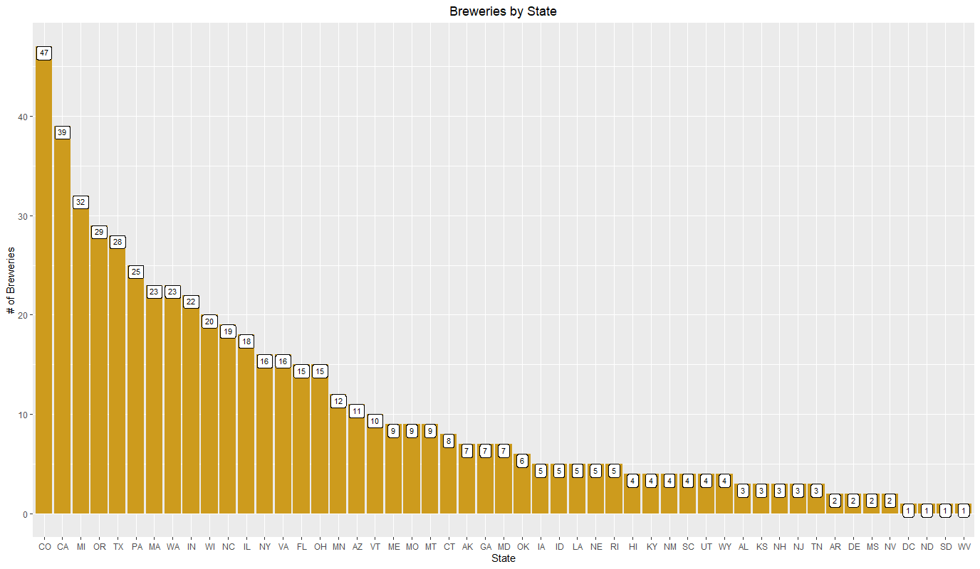
Breweries by State
West Virginia & DC only have one brewery each.
Recommendation to enter markets with fewer number of breweries

Slide 6
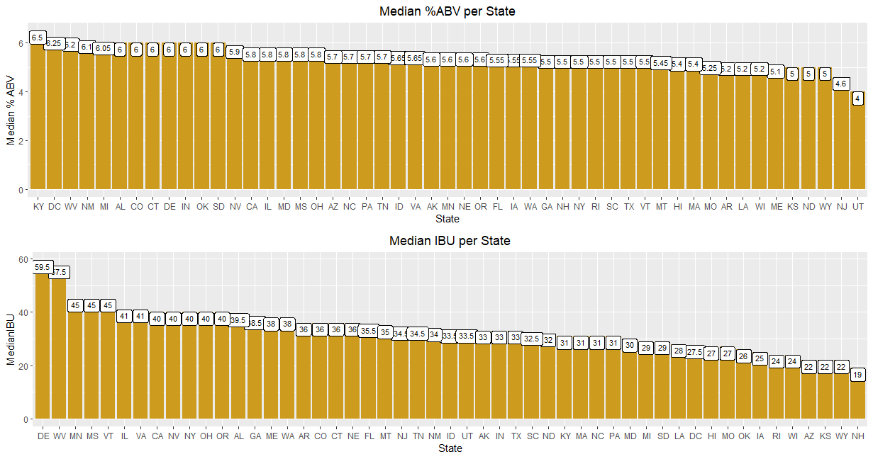
Median % ABV / IBU per State
DC in top 5 median ABV, WV in top 5 ABV & IBU.

Slide 7
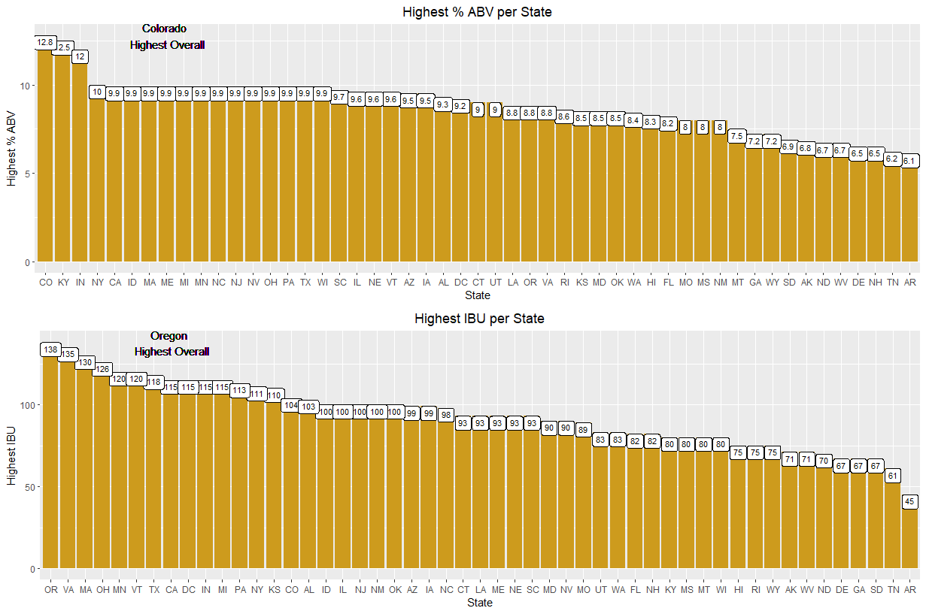
Highest % ABV/IBU
Highest ABV = 12.8 %
Highest IBU = 138
Colorado Highest ABV, and higher-end IBU at 104.
How are Budweiser’s sales in this market, only having products with low ABV/IBU? May be an opportunity compete.

Slide 8
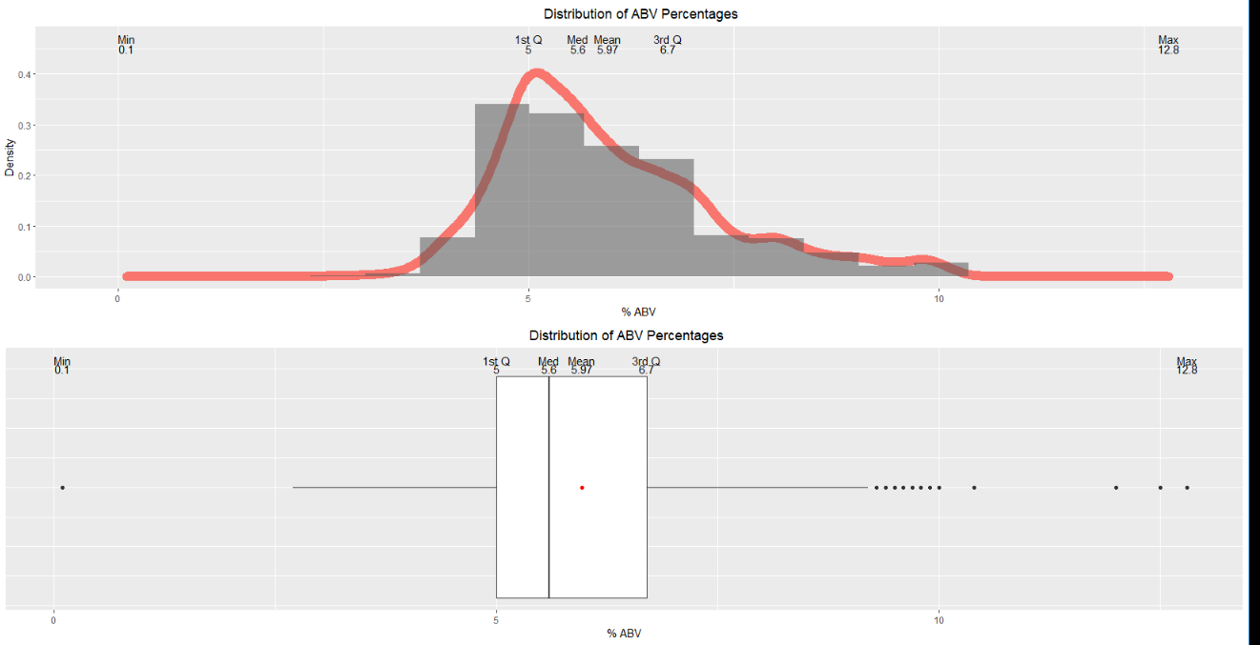
Summary of % ABV
Right-skewed with some outliers. 5 - 7% most popular ABV production.
Notes:
Also ran the summary data with the single NA beer removed that has a .1% ABV, but the only statistic that changed was the minimum. So the data point was left in.

Slide 9
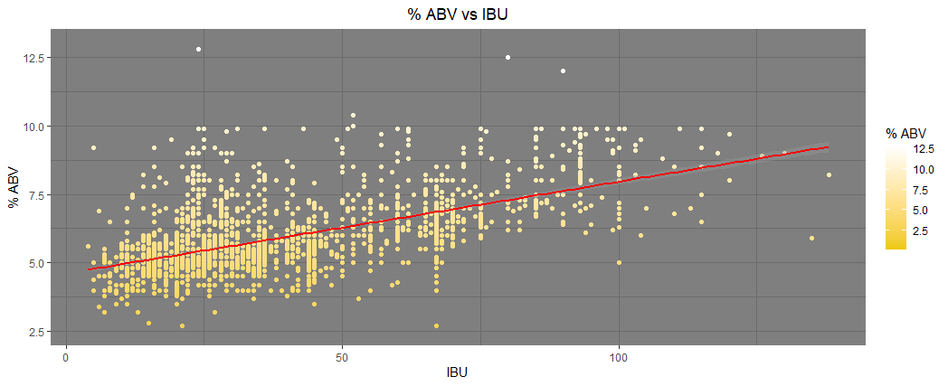
Correlation Between % ABV & IBU
There is overwhelming evidence that ABV and IBU are linearly correlated (p-value = <.0001).
60% of the variation in %ABV is explained by IBU
Study was observational and by no means intends to establish causation between %ABV and IBU

Slide 10
% ABV Compared to IBU
Values are not interdependent:
% ABV is determined by yeast amount and time to ferment
IBU is a result of quantity/type of hops
Breweries are making higher % ABV beers with higher IBU, with exceptions. Why?
Consider surveying to find if customer preferences between the two are related. Does the higher IBU make higher ABV more palatable?

Slide 11
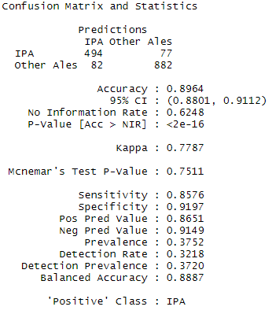
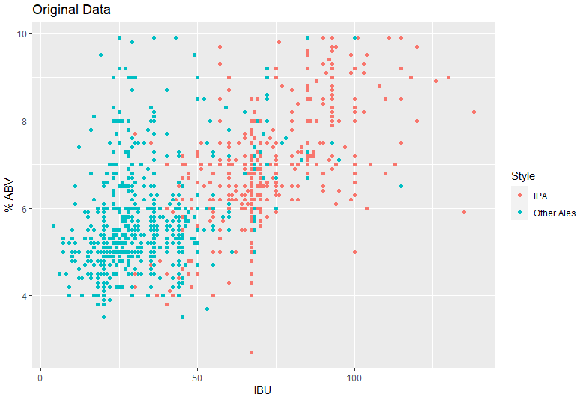
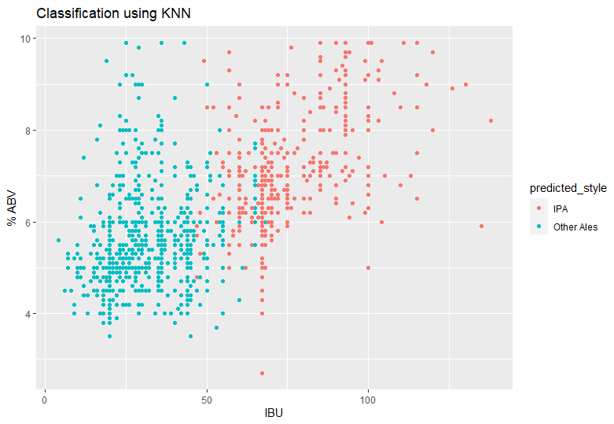
Prediction Model
What this means:
Model allows for classification of a beer as an IPA or Other Ale using ABV and IBU, with almost 90% accuracy.
Could be used to make comparisons of either type to other styles.
Overall
Percent of Correctly Classified IPAs
Percent of Correctly Classified “Other” Ales

Slide 12
Link
https://youtu.be/xGFg6L0SxzU

Slide 13
Citations
The Untappd Team (n.d.). OktoberFiesta - Freetail Brewing Co. Retrieved from https://untappd.com/b/freetail-brewing-co-oktoberfiesta/79567
The Untappd Team (n.d.). Kilt Lifter - Four Peaks Brewing Company. Retrieved from https://untappd.com/b/four-peaks-brewing-company- kilt-lifter/4055
The Untappd Team (n.d.). Golden Frau - Thunderhead Brewing. Retrieved from https://untappd.com/b/thunderhead-brewing-golden-frau/38392
The Untappd Team (n.d.). Southern Cross Belgian Double Red Ale - Hawai’i Nui Brewing. Retrieved from https://untappd.com/b/hawai-i-nui- brewing-southern-cross-belgian-double-red-ale/29698
The Untappd Team (n.d.). Weiss Weiss Baby - Figueroa Mountain Brewing Co. Retrieved from https://untappd.com/b/figueroa-mountain-brewing- co-weiss-weiss-baby/1043342

